Slide 1
Python:- Bill Management System
The system allows users to add items to a shopping cart, calculate the total cost, apply discounts, remove items, and generate an invoice with a unique number.
by PRASHANT GADALE
PG

Slide 2
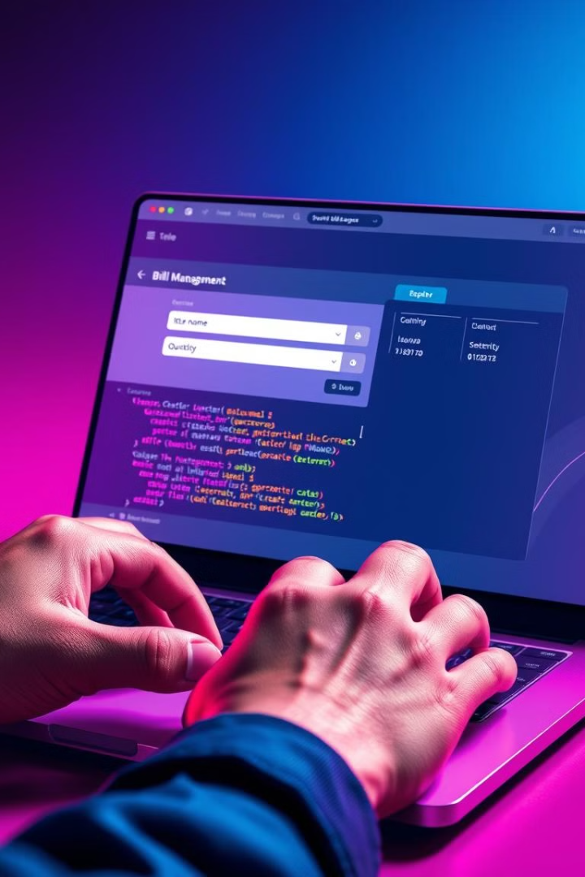
Setting Up the System
1
Initialization
We begin by creating an empty list called "items" to store the items in our bill. This list will act as a shopping cart.
2
User Interaction
The system prompts the user to enter the number of items they wish to add. Then, it uses a loop to gather details for each item, including its name, quantity, and unit price.
3
Item Data Structure
Each item is stored as a dictionary within the "items" list. This dictionary contains keys for "name", "quantity", and "unit_price", making it easy to organize and access item information later.
4
Printing the Items
After adding items to the list, the system prints the "items" list to visually verify the data that has been entered.

Slide 3
Calculating the Total Cost
Iterating through Items
Displaying Item Totals
Accumulating the Total
A "for" loop iterates through each item in the "items" list.
The system displays the individual cost for each item. It prints the item's name, quantity, unit price, and the calculated total cost.
The "total_amount" variable accumulates the individual costs of all items in the shopping cart, providing a running total.
For each item, the code multiplies the item's quantity by its unit price to calculate the item's total cost. This cost is then added to the "total_amount" variable.

Slide 4
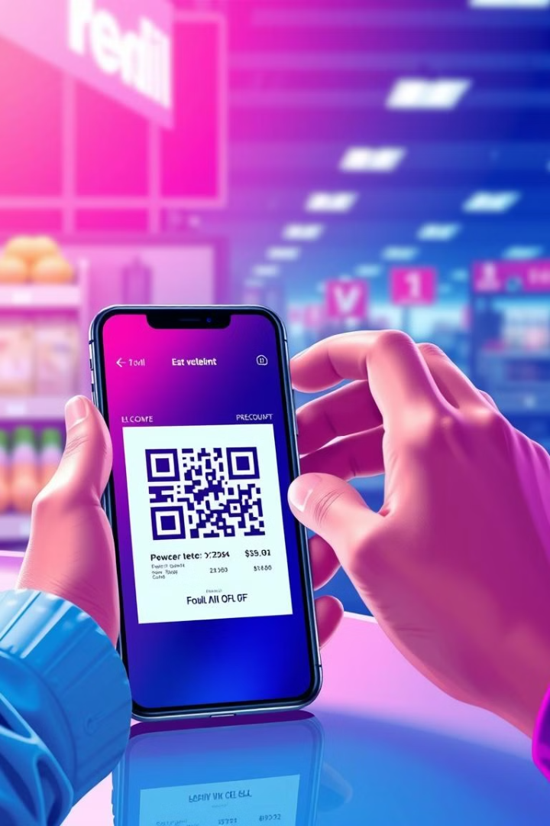




Adding Discount Functionality
User Input
The system prompts the user to enter a discount percentage.
Discount Calculation
The code calculates the discount amount by multiplying the "total_amount" by the discount percentage (divided by 100).
Applying the Discount
The discount amount is then subtracted from the "total_amount" to reflect the discounted price.
Displaying the Discount
The system prints a message indicating that the discount has been applied, showing the discount percentage and the amount deducted from the total cost.

Slide 5
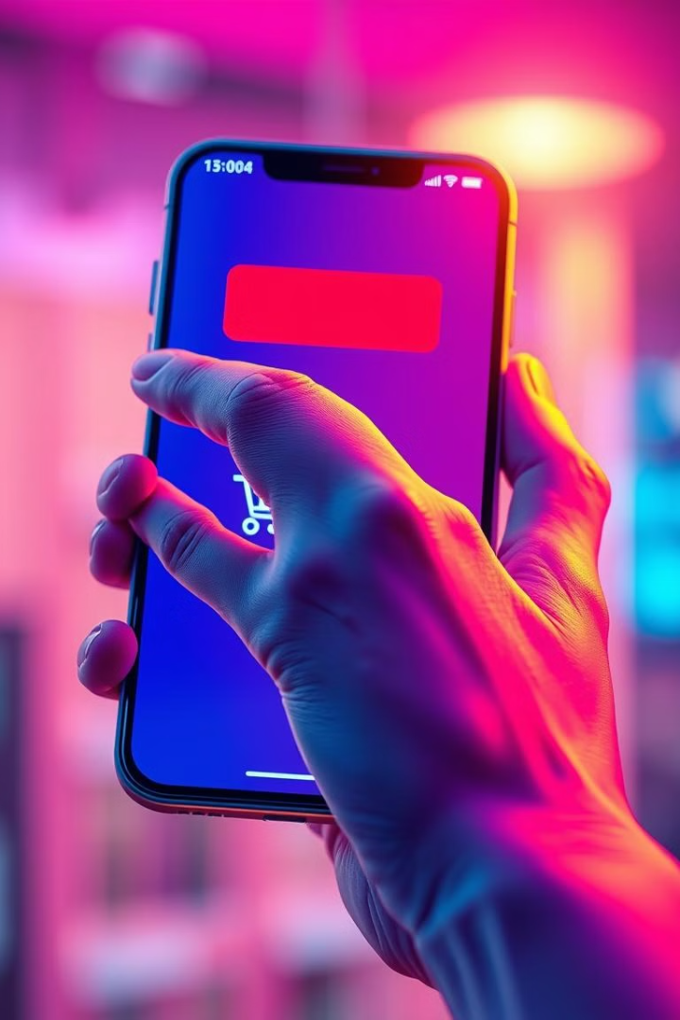
Removing Items from the Bill
1
User Input
The system asks the user if they want to remove an item. If the user responds "yes", they are then prompted to enter the name of the item they want to remove.
2
Item Removal
The code uses list comprehension to create a new list called "items" containing only the items whose names do not match the item to be removed. This effectively removes the selected item from the shopping cart.
3
Confirmation
If the user answers "no" to the removal prompt, the system does nothing, allowing the user to proceed to the next step.

Slide 6
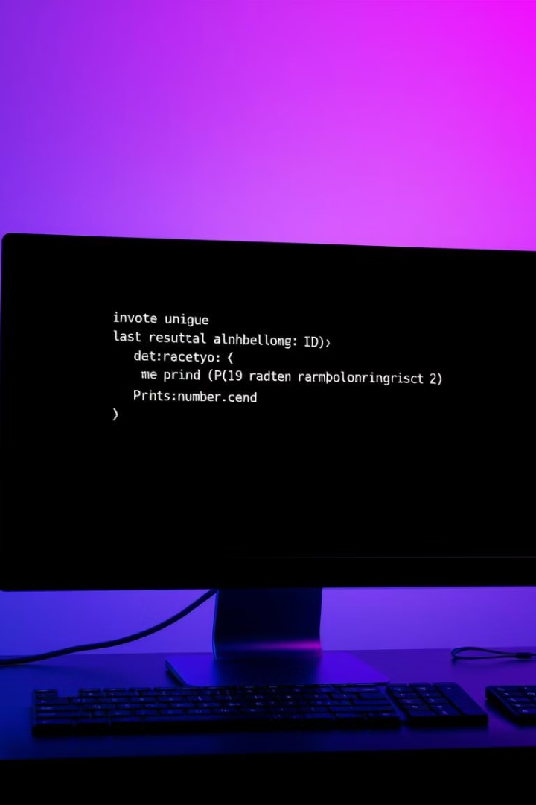

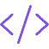

Generating a Unique Invoice Number
Unique Identifier
To create a unique invoice number, the system utilizes the "uuid" module from Python's standard library. This module provides a convenient way to generate universally unique identifiers (UUIDs).
Generating the UUID
The code generates a random UUID using the "uuid.uuid4()" function. This function produces a unique 128-bit identifier, ensuring that each invoice has a distinct number.
Displaying the Invoice Number
The system prints the generated UUID as the invoice number, providing a unique identifier for the customer's purchase.

Slide 7

Creating the Bill Object
Attribute
Description
invoice_number
Stores the unique invoice number generated using the "uuid" module.
total_amount
Stores the final total amount of the bill, including any discounts applied.
print_receipt
A method that prints a formatted receipt containing the invoice number, date, and total amount, along with a thank-you message.

Slide 8
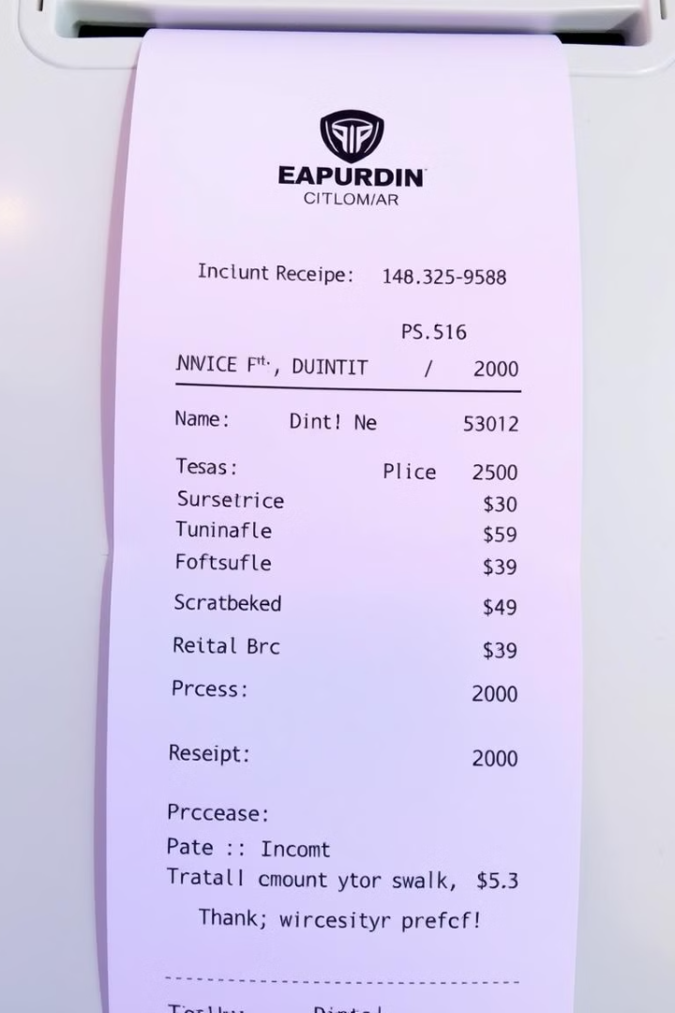
Printing the Receipt
Formatting
The "print_receipt" method prints a formatted receipt, including the invoice number, the current date, a separator line, the final total amount, and a concluding thank-you message.
Details
The receipt includes essential information such as the invoice number, the current date, and the total amount. This helps customers keep track of their purchases and facilitates order management.
Thank You
The receipt concludes with a polite thank-you message, reinforcing a positive customer experience. It also encourages customers to return to the shop.

